Slide 1

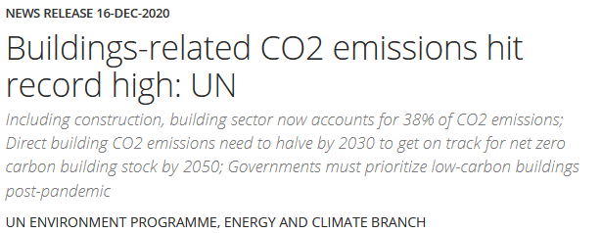
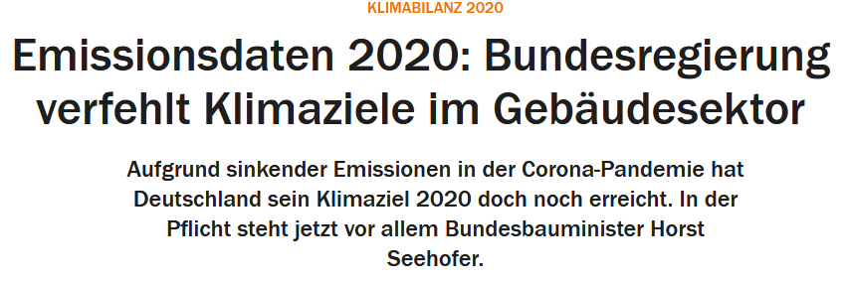
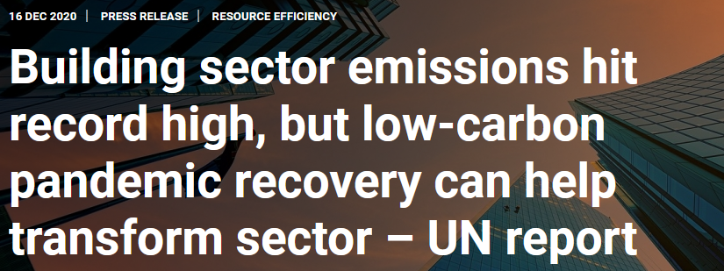
menti.com
code: 7428 8744

Slide 2
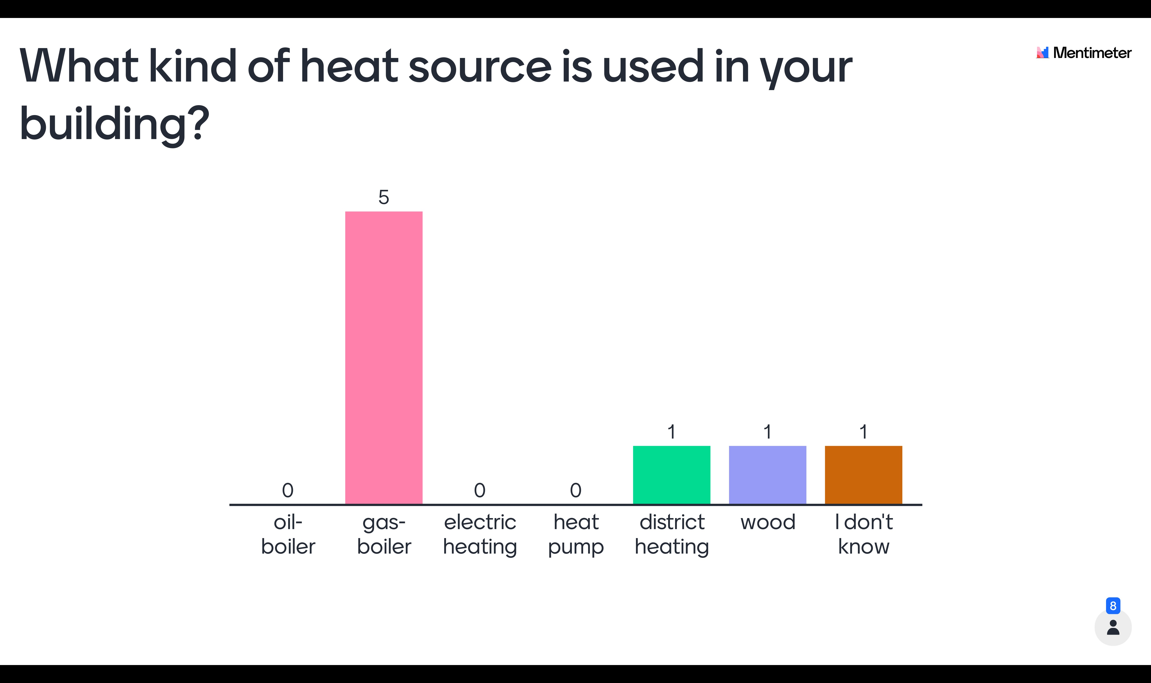

Slide 3
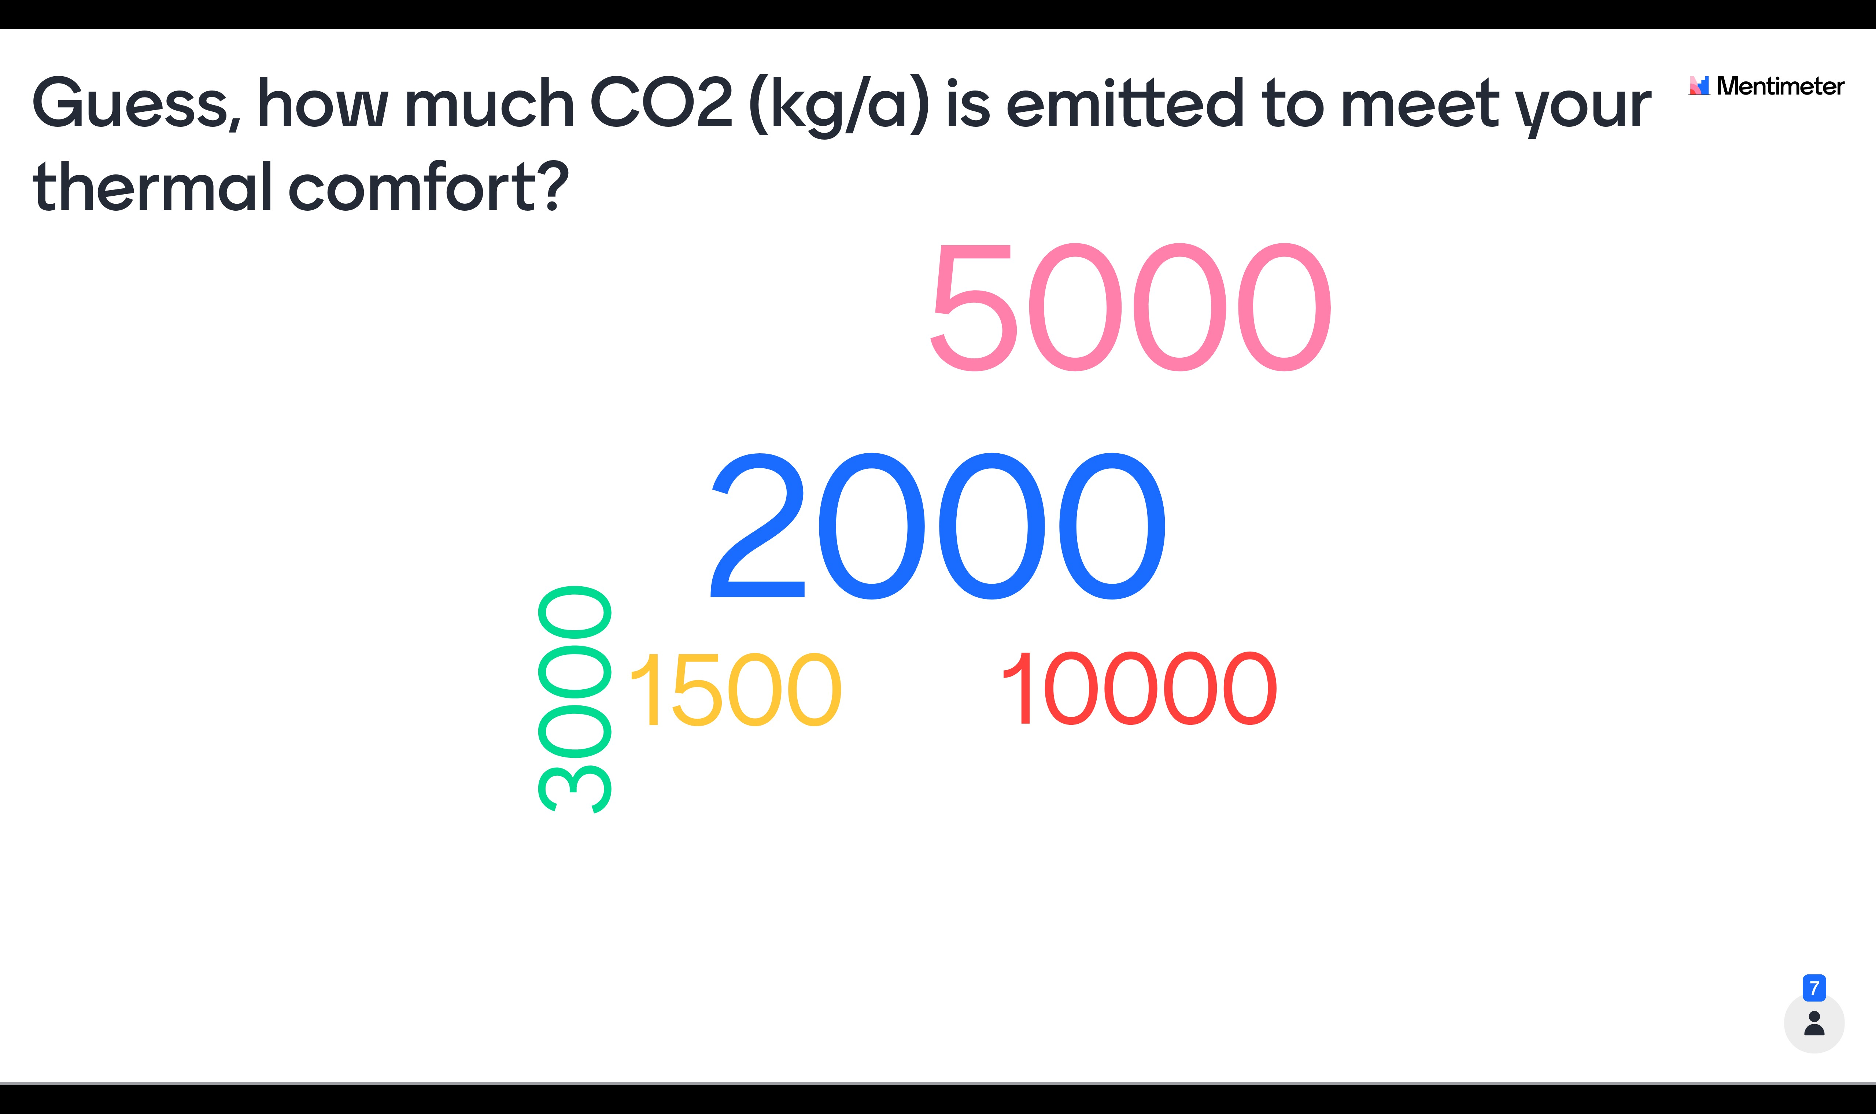

Slide 4

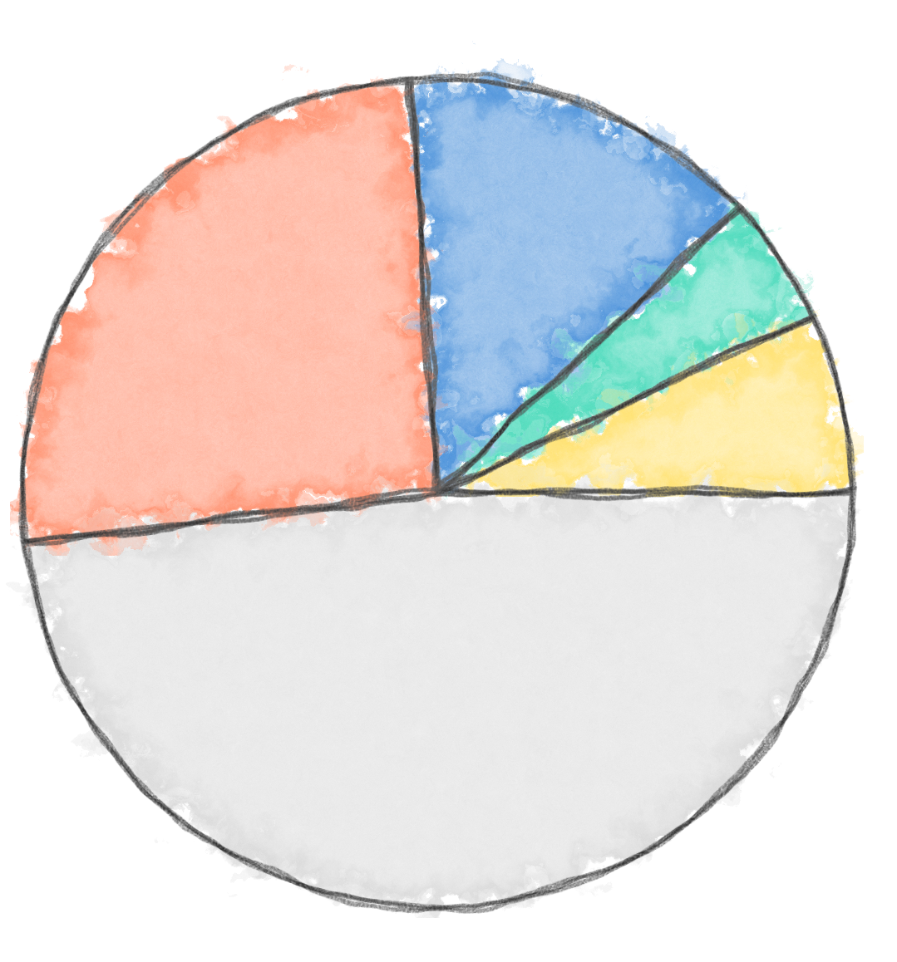
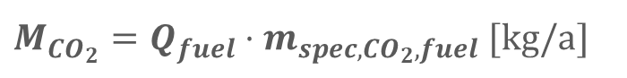
Heat supply systems for residential Buildings in Germany
Others
7.5 %
Electric, e.g HP
Gas boiler
4.8 %
48.2 %
Distric Heat
$M_{CO_{2}}=Q_{fuel}⋅m_{spec,CO_{2},fuel}$ $[kg/a]$
13.9 %
Oil boiler
25.6 %
$$m_{spec,CO_{2},fuel }: specific CO_{2}emissions fuel [kg/kWh]$$
$$Q_{fuel}:Final energy (energy effort of generation) [kWh/a]$$
[https://www.unika-kalksandstein.de/downloads-unika/category/19-waermeschutz.html?download=109:geg-2020]
Notes:
Discuss menti results and show averages.
As you see there is a lot potetial to save co2 emissions in the building sector. And we are all involved, since we all live in a buildings that needs be heated.
Others: liquid gas, wood/pellet, coal

Slide 5

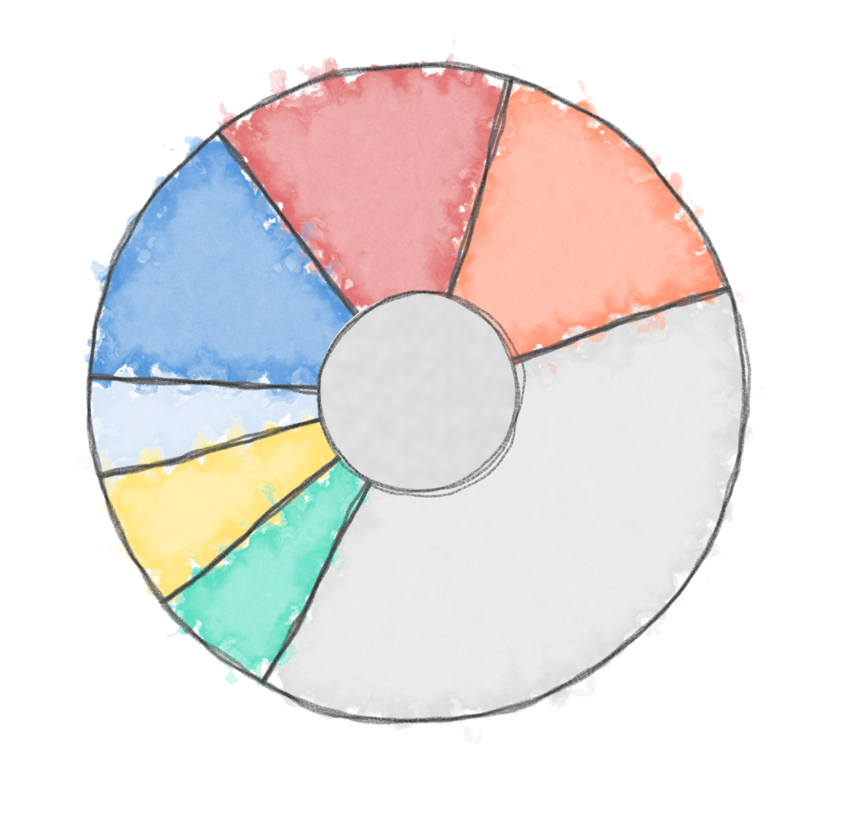
Average annual CO₂ emissions per capita in Germany
Heating
Food
1.75 t/a
Transport
1.75 t/a
1.61 t/a
4.7 t/a Global average
2.3 t/a CO₂ budget per capita to meet the 1.5 °C goal
11.6 t/a
Flights
0.58 t/a
0.79 t/a
Electricity
0.73
t/a
4.42 t/a
Consumption
Public Emissions
Global Carbon Project
[https://www.globalcarbonproject.org/carbonbudget/20/files/GCP_CarbonBudget_2020.pdf]
Bundesumweltministerium
[https://www.ndr.de/ratgeber/klimawandel/CO2-Ausstoss-in-Deutschland-Sektoren,kohlendioxid146.html]
Notes:
Data sources:
[Global Carbon Project, https://www.globalcarbonproject.org/carbonbudget/20/files/GCP_CarbonBudget_2020.pdf]
Bundeumweltministerium: https://www.ndr.de/ratgeber/klimawandel/CO2-Ausstoss-in-Deutschland-Sektoren,kohlendioxid146.html

Slide 6

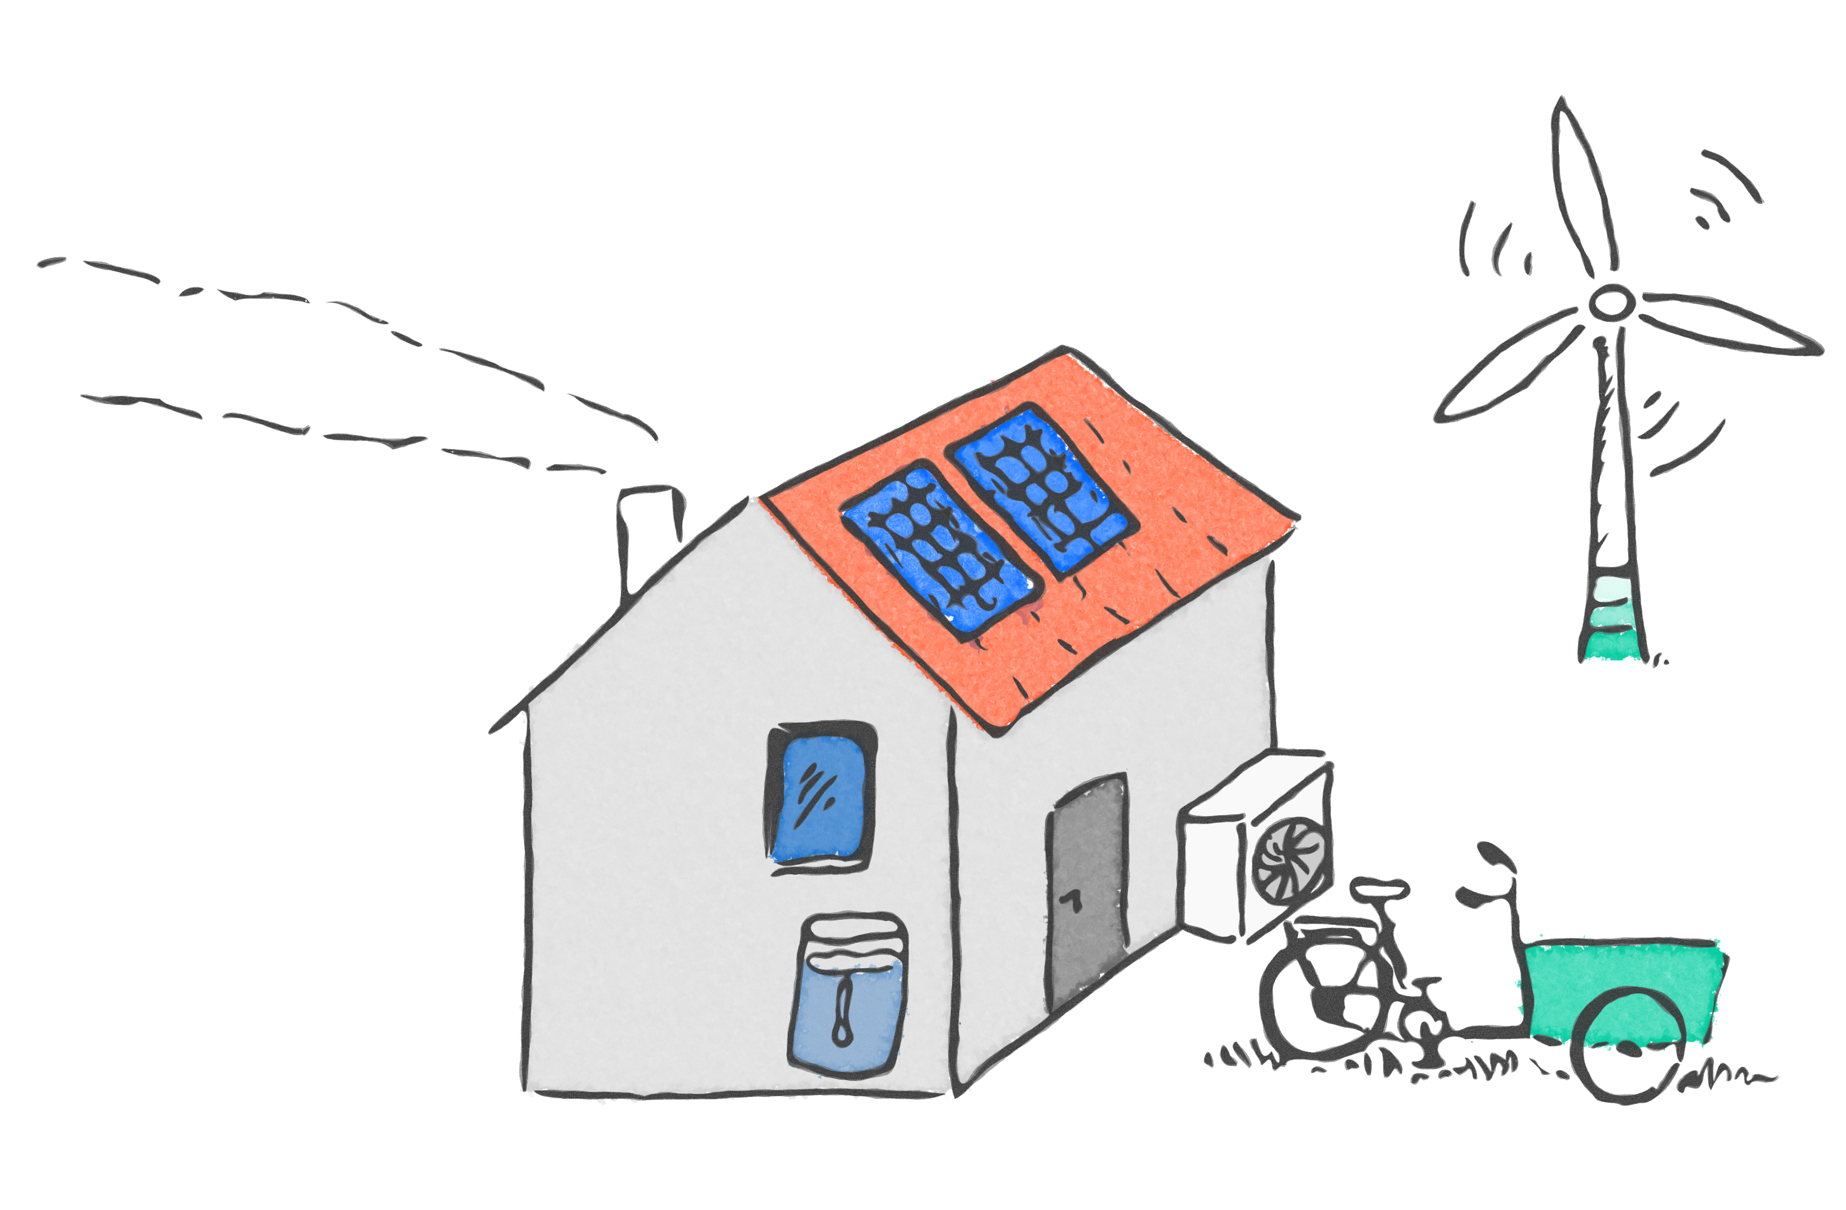
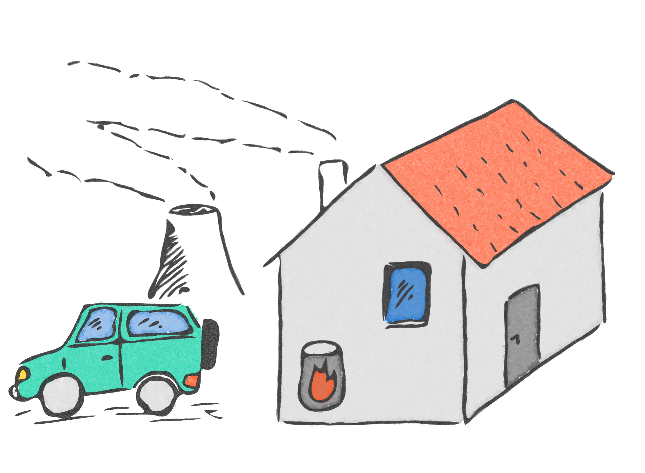
4. Reduce primary energy demand & CO₂ emissions
Improve heating technology
Supply demand with renewable energies
3. Reduce final energy demand
Renovation
Change of user behavior
2. Calculate energy demand
Final energy demand
Primary energy demand
CO₂ emissions
1. Asses current state
Building: location, geometry, materials
System: technology, efficiency, size
User habit: comfort temp., ventilation
Notes:
This is a sketch of the current state, as seen in the prev. Graphs.
What is needed to change the current situation?
Other than changing our user behaviour, most of us are not in the postion to reneovate their flat or order an alternative heating system.
But from from our studies we gained lots of expertice in many of the supjects that are related to these topics
So what we could do is spread our knowledge to the house owners or landlords.

Slide 7
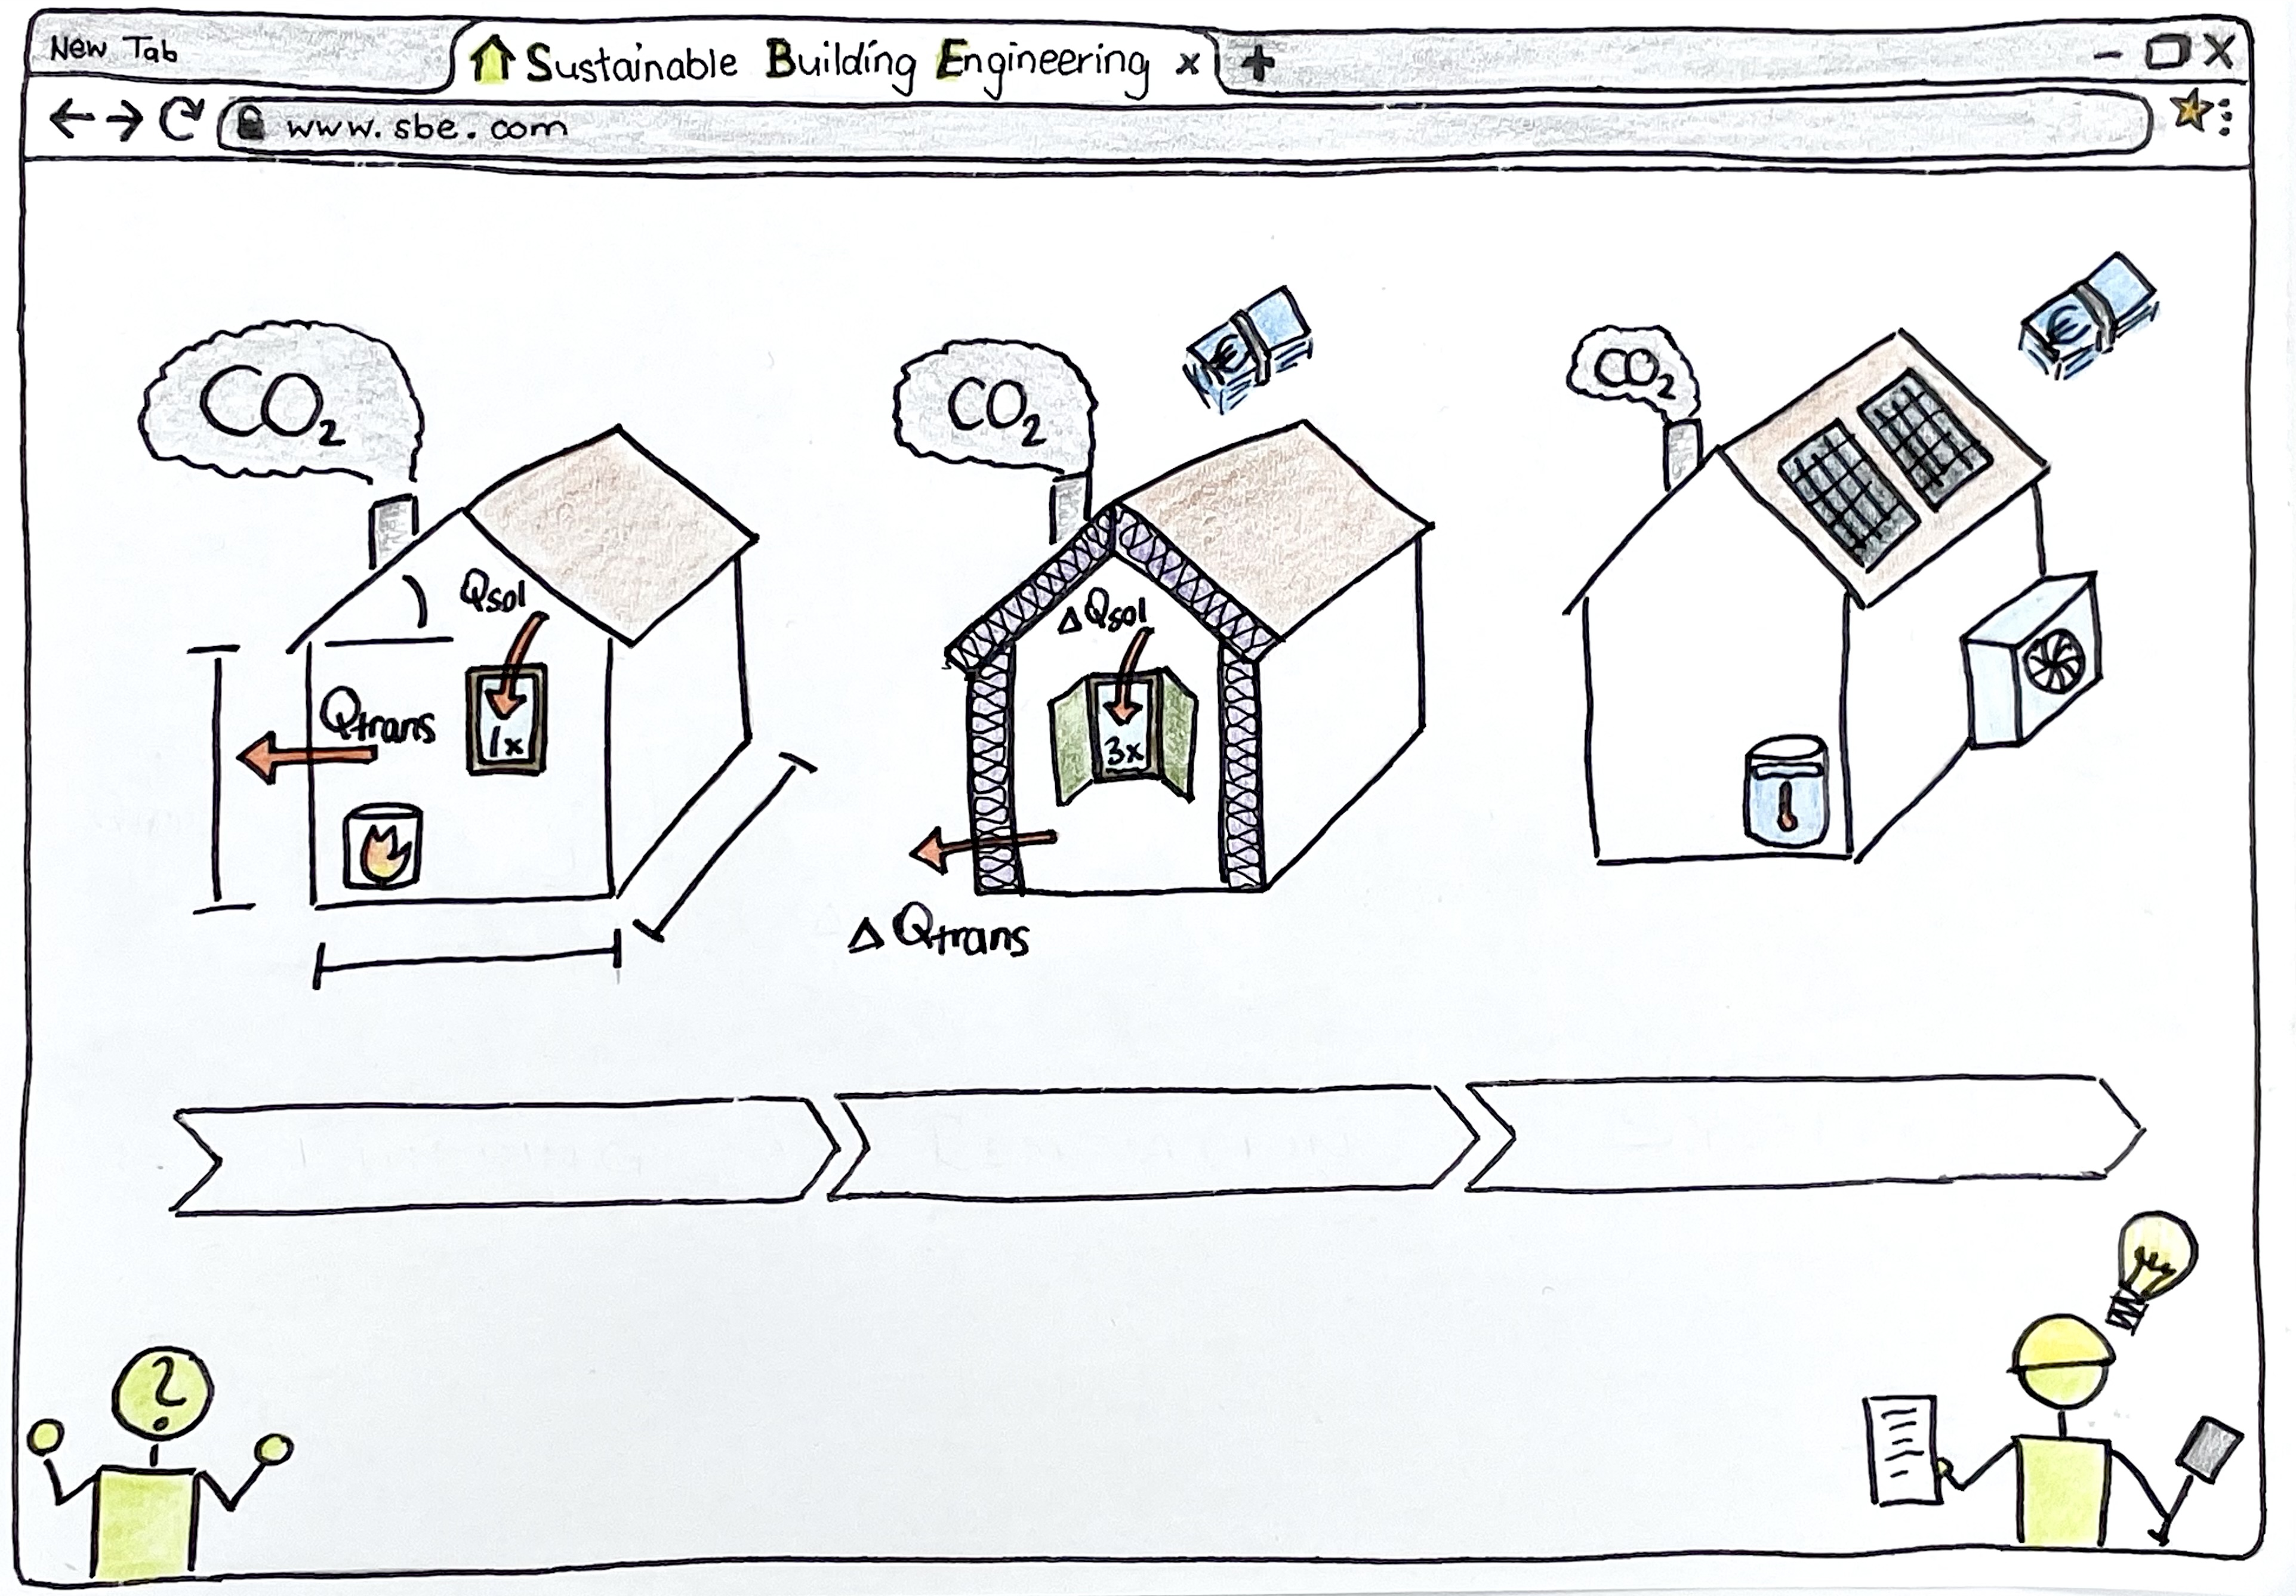

Building
Renovation
System
Notes:
This is how we imagine, to spread our experience…. WebApplication
Shown are the steps discribed in the slide before.
Inform and motivate people and hopefully also landloards,

Slide 8
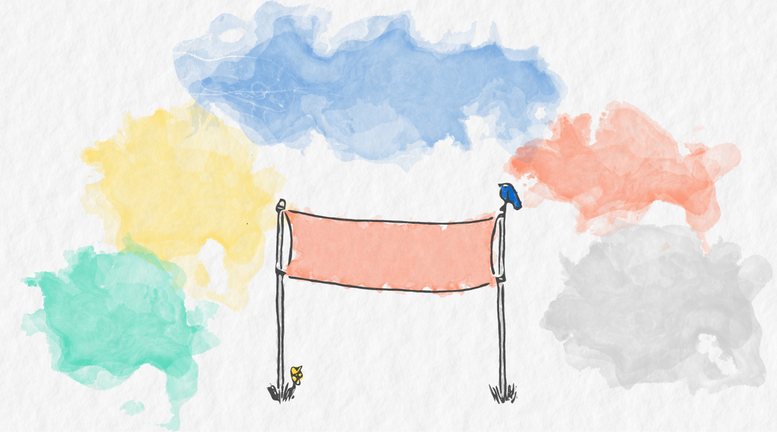
Simulation Tool
Building, Renovation & System
Techno-economic & ecological
Python based
User Interface
Intuitv
Gamification
No prerequists
Experience & Teamwork
Technical
Social
G O A L
Organisation
Voluntary
Non-profit
Without hierarchies
Easy to acces
Online
Free & open source
Notes:
What do we want to achieve with such a WebApp?
-Simulation tool:
We don‘t want to rewrite polysun with all it‘s components, and also not EnergyPlus with it‘s deep physical approach.
Instead the focus should rather be on modelling different refurbishment scenarios of building envelope and energy supply system to gain a broad overview of possibilities
Organisation: without hierarchies
We don‘t want to have a boss who tells others what to do.
Instead we want to discuss about ideas and realize them in small self-organized working groups with their own responsibilities.

Slide 9

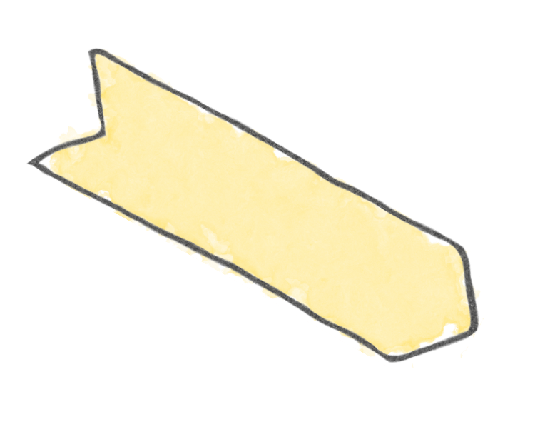







Implementation
Ideas
???
Knowledge
Demonstrate
Develope
Discuss
Awareness for CO₂ in Buildings
Research
Web App
Initiative
Python library
Time
Notes:
Let‘s have a closer look on how we want to develop such a web app.
- First of all we need a great collection of ideas from different perspectives – and this is where hopefully some of you come into play.
Knowledge from different specialization areas
Even though we‘ll have knowledge gaps, that need to be filled with lots of research.
As mentioned before, nobody will tell us what to do, so self-initiative and motivation will be required.
And of course all of this takes time.
Protoyping cycle – everyone is working on a small part and step by step the prototype gets bigger
All of this input we need to discuss, develope and demonstrate again and again and put it all together, so that we can develop a Web App that creates awareness for the CO2 emissions of buildings among the users.
On the way we hopefully create some other usefull output for example reusable code snippets that could be published as python libraries, or a collection of graphics. And further unforseable output.

Slide 10
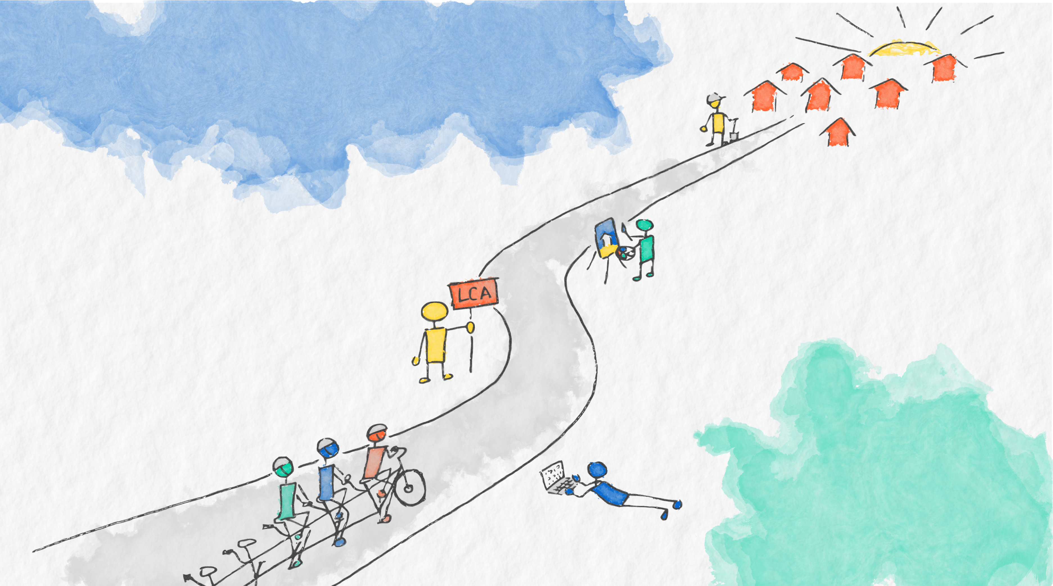
Thanks for your attention!
Next online meeting:
http://tiny.cc/rehome
Notes:
If you have allways dreamed of writing a web app for building assesment you are welcome to jump un the bike starigt away.
Or if this sounds fun to you and you are interested to work in a team, and you are looking for a challenge to spend some time on you are also very welcome on board.
At the moment I am working for my master thesis in techno-economic analysis… maybe a master thesis topic for you. Burcu is planning to write her master thesis about LCA of building components.
Lukas is doing the Python course and wants to implement the „current state assessment“ in his python project.
Ludwig has been working as a hiwi on PVT collectors and knows a lot about component modelling and has a lot of knowledge to share with us.
We prepared a little doodle survey to organize a date for the next meeting to discuss the next steps.
Thank you!

